Slide 1
FINANCIAL PORTFOLIO PLANNER
By Bryan Lu, Cherryl Adzang, John Nguyen, Philipee Timothe, and Vadim Yermak

Slide 2
Agenda
Executive Summary
Concept
Technologies
Data Collections
Approach
Challenges
Questions

Slide 3

Executive Summary
Financial Portfolio Planner allows user to research stocks and create a portfolio.
The application helps the user predict their potential returns for investment and expertise to assist them wealth amplifications.
The application allows for users to preview the expected return for stocks and given their appetite for risk.

Slide 4

Concept
A financial portfolio planner is a tool or approach used to optimize the allocation of investments within a portfolio based on an individual's financial goals, risk tolerance, and investment preferences.
Asset Allocation
Risk Management
Diversification
Rebalancing
Investment Selection
Performance Monitoring
Financial Goals

Slide 5

Technologies
Python: A versatile programming language widely used for various purposes, including data analysis, web development, artificial intelligence, and scientific computing.
Pandas: A powerful library for data manipulation and analysis, offering data structures like DataFrames and tools for handling structured data.
Monte Carlo simulation: A technique used to model the potential future performance of a stock or a portfolio of stocks. It involves simulating a large number of possible future scenarios based on historical data and statistical assumptions.
Notes:
Questionary and user input
Understanding financial concepts

Slide 6
Data Collection
A data collection API (Application Programming Interface) is a set of rules and protocols that allows developers to retrieve, submit, and manipulate data from a particular data source or service.
Data collection APIs can be used to automate the process of collecting data from various sources, such as databases, web services, IoT devices, social media platforms, and more.
Alpaca is a technology company that provides a modern commission-free stock trading platform and API for developers.

Slide 7
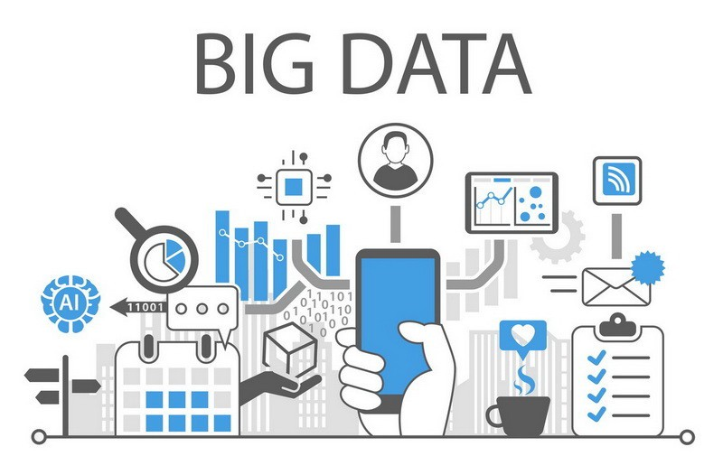
Approach
-Friendly Command Line Interface
-Modular Programming
-Custom Functions
-Financial Concepts

Slide 8
Challenges
-Initial difficulty visualizing the project concept
-Cleaning up modular code
-Incorporating everything into a single script
-Limited data access
-Being realistic with expectations and timelines

Slide 9

Questions?

